Slide 1
Computer Organization Principles
School of Software, Dalian University of Technology
Chi Lin (林驰)
chilin@mail.dlut.edu.cn

Slide 2
Chapter 2 Overview of Computer Science Systems
Contents
OS Brief Overview
Compiler
Principles of Computer Systems Architecture
Course Importance & Meaning
Abstraction (Optional)
Homework

Slide 3
Chapter 2 Overview of Computer Science Systems
Contents
OS Brief Overview
Compiler
Principles of Computer Systems Architecture
Course Importance & Meaning

Slide 4
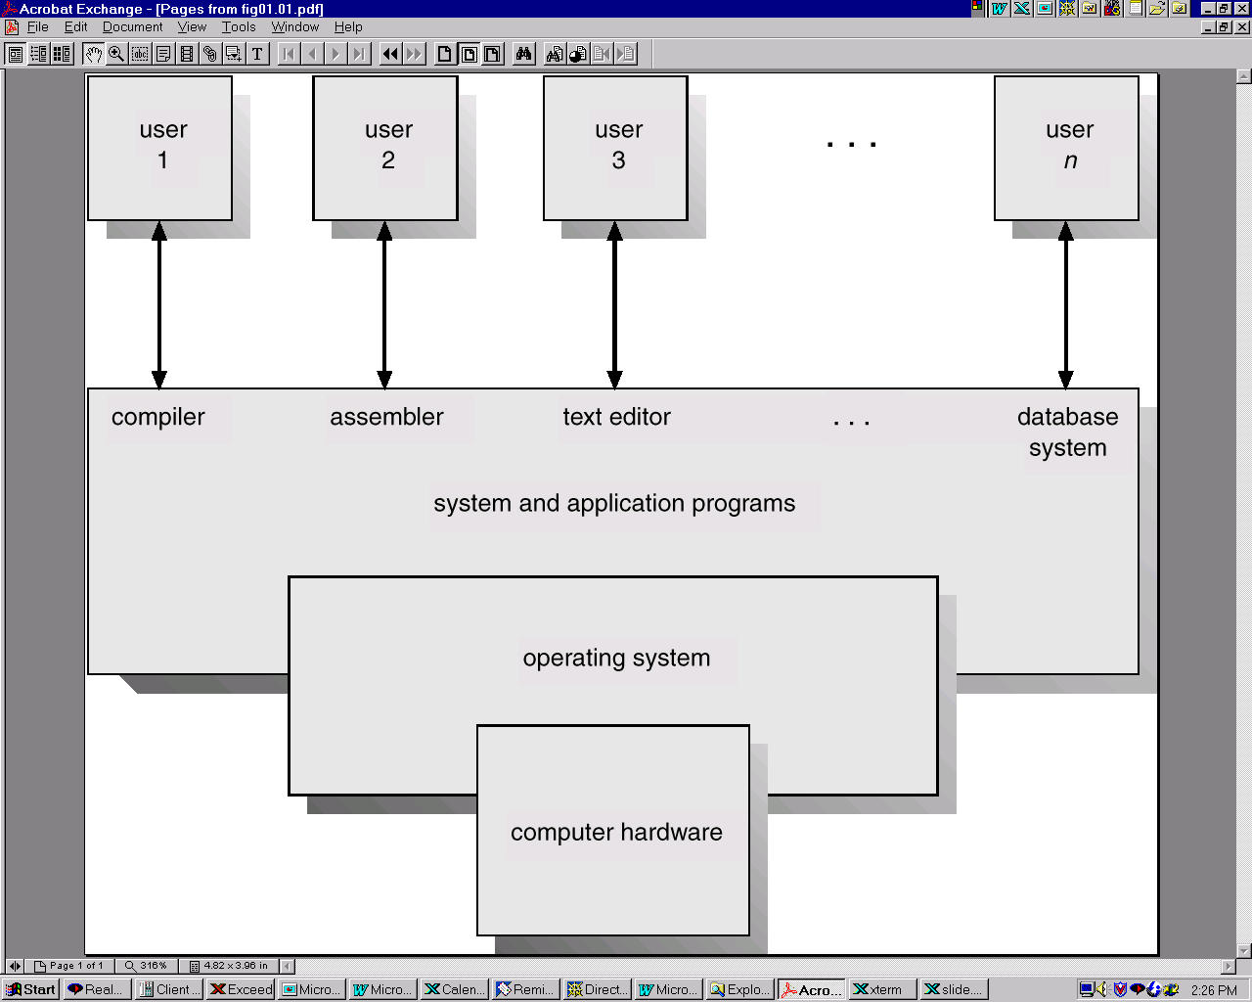
Computer System Components
Hardware
OS
Applications
Users

Slide 5
OS Definition
An operating system (OS) is software that manages computer hardware and software resources and provides common services for computer programs.
The operating system is an essential component of the system software in a computer system. Application programs usually require an operating system to function.

Slide 6
Operating System Virtual Machine (OSVM)
M4 (HLVM)
Software
M3 (ALVM)
M2 (OSVM)
M1 (AM)
Hardware
M0 (MM)
OS: Manage hardware, provide user interfaces for low level machine

Slide 7
OS Brief Overview
What ?
A program that acts as an intermediary between a user of a computer and the computer hardware.
Why ?
Execute user programs and make solving user problems easier.
Make the computer system convenient to use.
Who ?
Users, developers, .etc.
Where?
Between actual machine & assembly language machine.
How ?
Use the computer hardware in an efficient manner.
What is an OS composed of ???

Slide 8
OS Components
Kernel
Program execution
Interrupts
Modes
Memory management
Virtual memory
Multitasking
Disk access and file systems
Device drivers
Networking
Security
User interface
Graphical user interfaces

Slide 9
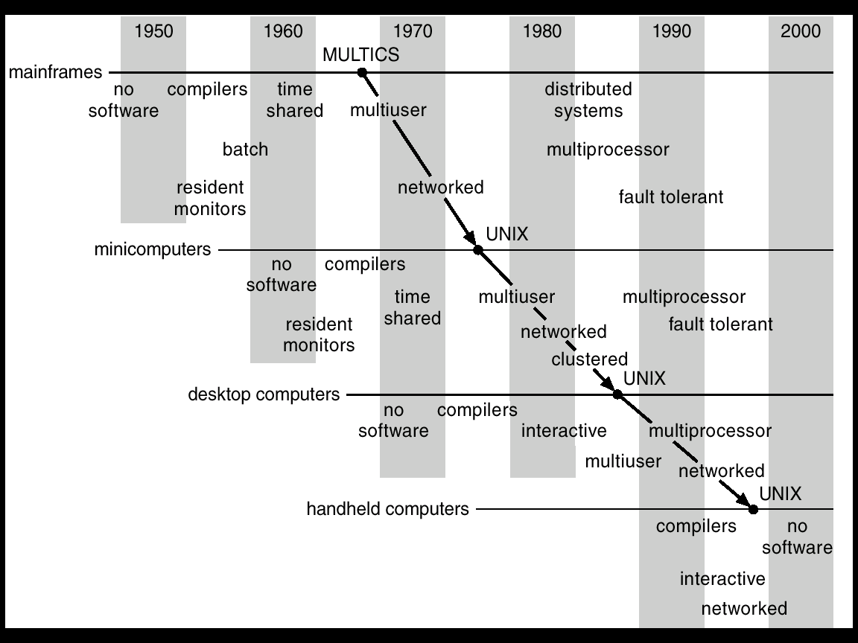
Migration of Operating-System Concepts and Features

Slide 10
System Functionality
Process Management
Memory Management
Device Management
File Management
User Interface

Slide 11
Process Management
Process control
Process scheduling
Process synchronization
Process communication

Slide 12
Memory Management
Memory Control
Memory Protection
Memory Mapping
Memory Expansion

Slide 13
Device Management
Device Operation
Virtual Devices
Cache Management

Slide 14
File Management
File Storage Management
Directory Management
Read/Write Manage
Storage Control

Slide 15
User Interface
System Command
Programmable Interface
Graphical Interface

Slide 16

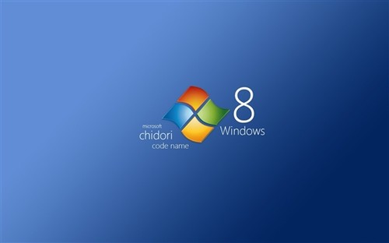

Desktop Systems

Slide 17
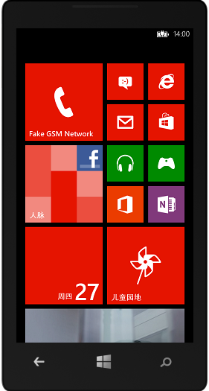


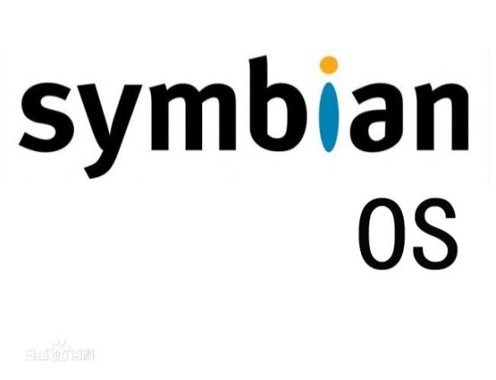
Handheld Systems

Slide 18
Typical Embedded Operating System
µC/OS-II
VxWorks
WinCE
Linux

Slide 19
µC/OS-II
Advantages: Open Source (开源), Tiny Structure（结构小巧）, Cuttable (可裁剪) , Preemptive(可抢占), Real time（实时）
High efficiency, small size, high portability(高可移植性)
64 Tasks are supported, with priority 0~63.
Developed by ANSI C, successfully transplanted on nearly 40 different kinds of processors.

Slide 20
WinCE OS
Multi-threads(多线程)、Multi-tasks(多任务)
High-modularity, useful for customizing from PC to controller.
Graphical Interface (图形界面)
Portable

Slide 21
Chapter 2 Overview of Computer Science Systems
Contents
OS Brief Overview
Compiler
Principles of Computer Systems Architecture
Course Importance & Meaning

Slide 22
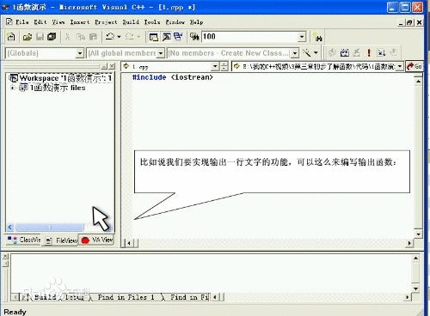
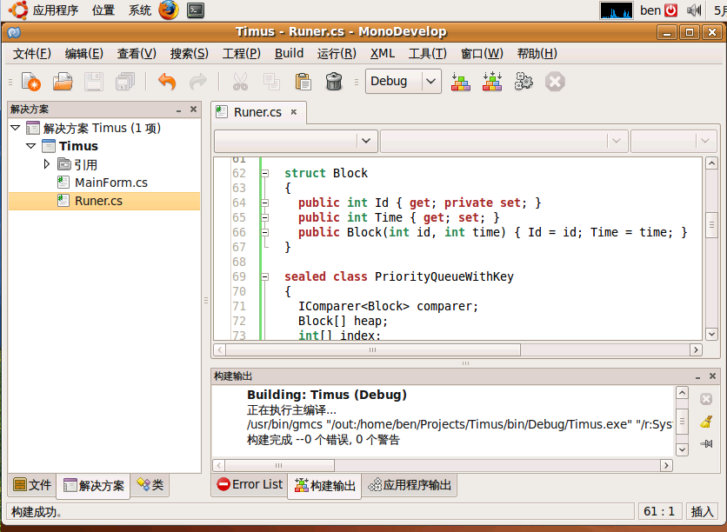
Compiler
A compiler is a computer program (or set of programs) that transforms source code written in a programming language (the source language) into another computer language (the target language, often having a binary form known as object code).
The most common reason for wanting to transform source code is to create an executable program.

Slide 23
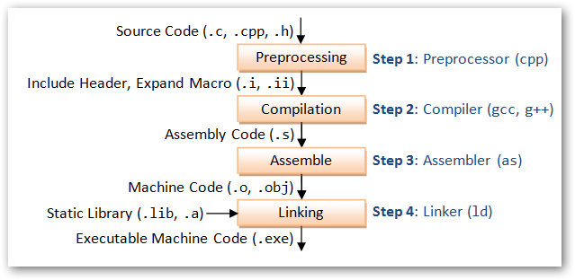
Compiling Process

Slide 24
Preprocessing
gcc -E test.c -o test.i or gcc -E test.c
Preprocessing phase. The preprocessor (cpp) modifies the original C program according to directives that begin with the # character.
For example, the #include <stdio.h> command in line 1 of hello.c tells the preprocessor to read the contents of the system header file stdio.h and insert it directly into the program text.
The result is another C program, typically with the .i suffix.

Slide 25
Compilation
gcc -S test.i -o test.s
Compilation phase. The compiler (cc1) translates the text file hello.i into the text file hello.s, which contains an assembly-language program. Each statement in an assembly-language program exactly describes one low-level machine-language instruction in a standard text form.

Slide 26
Assembly
gcc -c test.s -o test.o
Assembly phase. Next, the assembler (as) translates hello.s into machine language instructions, packages them in a form known as a relocatable object program, and stores the result in the object file hello.o.
The hello.o file is a binary file whose bytes encode machine language instructions rather than characters. If we were to view hello.o with a text editor, it would appear to be gibberish.

Slide 27
Linking
gcc test.o -o test
Notice that our hello program calls the printf function, which is part of the standard C library provided by every C compiler. The printf function resides in a separate precompiled object file called printf.o, which must somehow be merged with our hello.o program. The linker (ld) handles this merging.
The result is the hello file, which is an executable object file (or simply executable) that is ready to be loaded into memory and executed by the system.

Slide 28
Chapter 2 Overview of Computer Science Systems
Contents
OS Brief Overview
Compiler
Principles of Computer Systems Architecture
Course Importance & Meaning

Slide 29
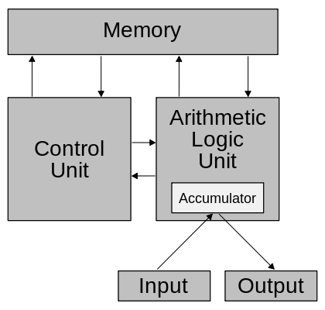
Von Neumann architecture
Memory
Calculator
Control Unit
Input / Output

Slide 30
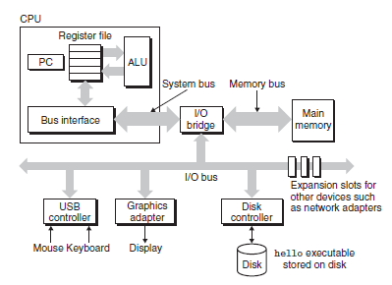
Hardware organization of a typical system

Slide 31
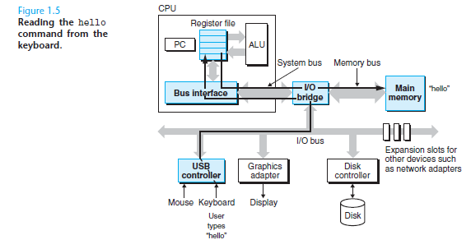
How to interpret hello? Step1: Reading hello command from keyboard

Slide 32
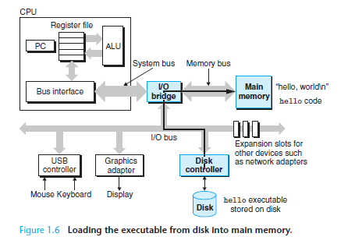
How to interpret hello? Step2: Loading the executable from disk into main memory

Slide 33
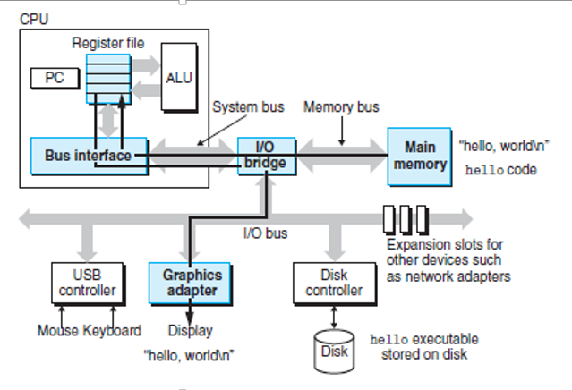
How to interpret hello? Step 3: Writing the output string from memory to the display

Slide 34
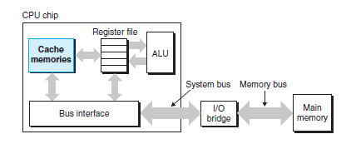
Cache Memories
A CPU cache is a cache used by the central processing unit (CPU) of a computer to reduce the average time to access data from the main memory.
The cache is a smaller, faster memory which stores copies of the data from frequently used main memory locations.
Most CPUs have different independent caches, including instruction and data caches, where the data cache is usually organized as a hierarchy of more cache levels (L1, L2 etc.)

Slide 35
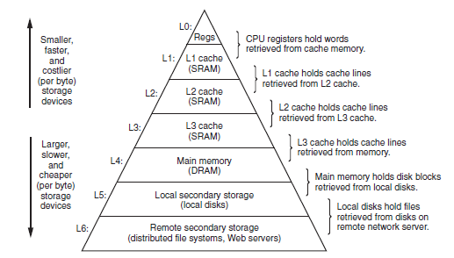
Memory Hierarchy

Slide 36
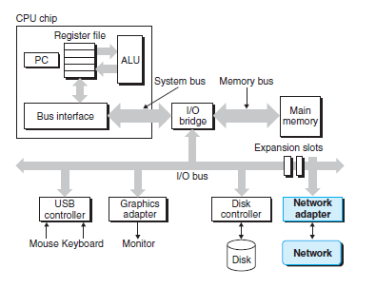
Communication with networking

Slide 37
Chapter 2 Overview of Computer Science Systems
Contents
OS Brief Overview
Compiler
Principles of Computer Systems Architecture
Course Importance & Meaning

Slide 38
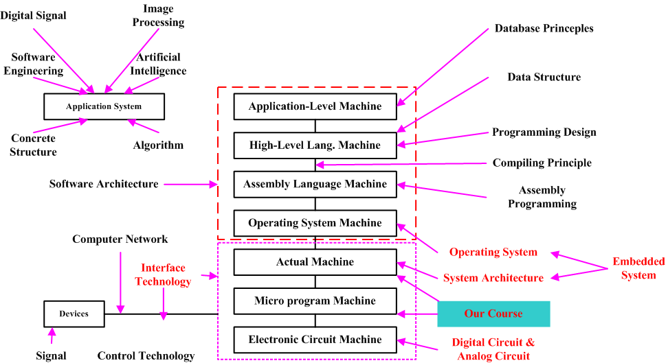
Importance and Meaning

Slide 39
Chapter 2 Overview of Computer Science Systems
Contents
OS Brief Overview
Compiler
Principles of Computer Systems Architecture
Course Importance & Meaning
Abstraction (Optional)
Homework

Slide 40
Five Realities for stimulating your interests
Abstraction
Five Realities
Ints are not Integers, Floats are not Reals
You’ve Got to Know Assembly
Memory Matters
There’s more to performance than asymptotic complexity
Computers do more than execute programs

Slide 41
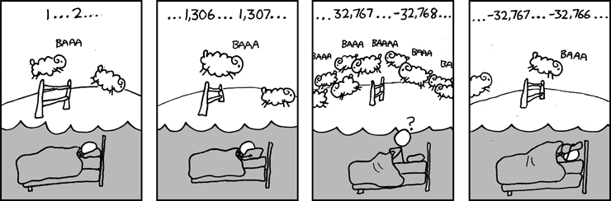
Great Reality #1: Ints are not Integers, Floats are not Reals
Carnegie Mellon
Example 1: Is x² ≥ 0?
Float’s: Yes!
Int’s:
40000 * 40000 = 1600000000
50000 * 50000 = ??
Example 2: Is (x + y) + z = x + (y + z)?
Unsigned & Signed Int’s: Yes!
Float’s:
(1e20 + -1e20) + 3.14 --> 3.14
1e20 + (-1e20 + 3.14) --> ??
Source: xkcd.com/571

Slide 42
Great Reality #2: You’ve Got to Know Assembly
Carnegie Mellon
Chances are, you’ll never write programs in assembly
Compilers are much better & more patient than you are
But: Understanding assembly is key to machine-level execution model
Behavior of programs in presence of bugs
High-level language models break down
Tuning program performance
Understand optimizations done / not done by the compiler
Understanding sources of program inefficiency

Slide 43
Great Reality #3: Memory Matters Random Access Memory Is an Unphysical Abstraction
Carnegie Mellon
Memory is not unbounded
It must be allocated and managed
Many applications are memory dominated
Memory referencing bugs especially pernicious
Effects are distant in both time and space
Memory performance is not uniform
Cache and virtual memory effects can greatly affect program performance
Adapting program to characteristics of memory system can lead to major speed improvements

Slide 44
Memory System Performance Example
Carnegie Mellon
void copyij(int src[2048][2048],
int dst[2048][2048])
{
int i,j;
for (i = 0; i < 2048; i++)
for (j = 0; j < 2048; j++)
dst[i][j] = src[i][j];
}
void copyji(int src[2048][2048],
int dst[2048][2048])
{
int i,j;
for (j = 0; j < 2048; j++)
for (i = 0; i < 2048; i++)
dst[i][j] = src[i][j];
}
21 times slower (Pentium 4)
Hierarchical memory organization
Performance depends on access patterns
Including how step through multi-dimensional array

Slide 45
The Memory Mountain
Carnegie Mellon
Intel Core i7
2.67 GHz
32 KB L1 d-cache
256 KB L2 cache
8 MB L3 cache

Slide 46
Great Reality #4: There’s more to performance than asymptotic complexity
Carnegie Mellon
Constant factors matter too!
And even exact op count does not predict performance
Easily see 10:1 performance range depending on how code written
Must optimize at multiple levels: algorithm, data representations, procedures, and loops
Must understand system to optimize performance
How programs compiled and executed
How to measure program performance and identify bottlenecks
How to improve performance without destroying code modularity and generality

Slide 47
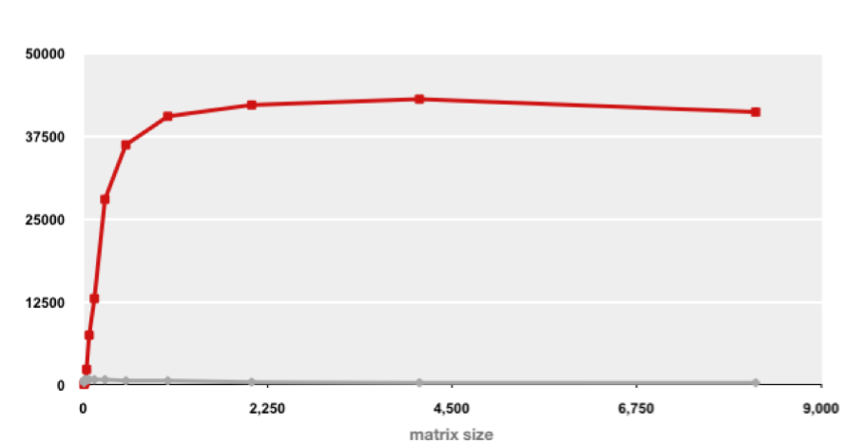
Example Matrix Multiplication
Carnegie Mellon
Matrix-Matrix Multiplication (MMM) on 2 x Core 2 Duo 3 GHz (double precision)
Gflop/s
Best code (K. Goto)
160x
Triple loop
Standard desktop computer, vendor compiler, using optimization flags
Both implementations have exactly the same operations count (2n³)
What is going on?

Slide 48
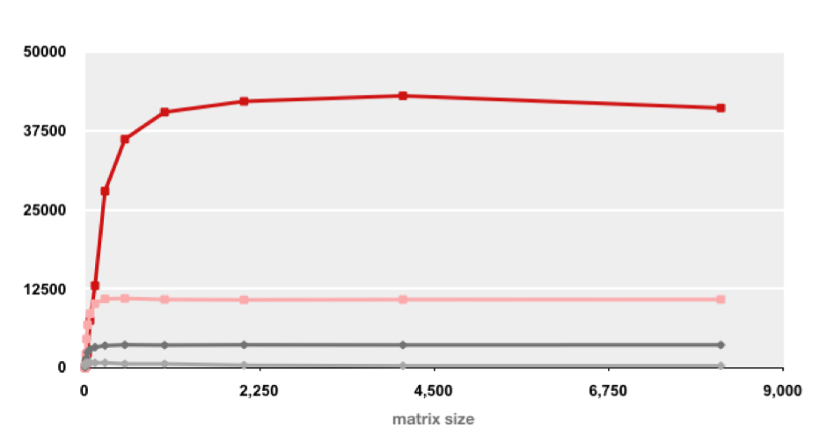
MMM Plot: Analysis
Carnegie Mellon
Matrix-Matrix Multiplication (MMM) on 2 x Core 2 Duo 3 GHz
Gflop/s
Multiple threads: 4x
Vector instructions: 4x
Memory hierarchy and other optimizations: 20x
Reason for 20x: Blocking or tiling, loop unrolling, array scalarization, instruction scheduling, search to find best choice
Effect: fewer register spills, L1/L2 cache misses, and TLB misses

Slide 49
Great Reality #5: Computers do more than execute programs
Carnegie Mellon
They need to get data in and out
I/O system critical to program reliability and performance
They communicate with each other over networks
Many system-level issues arise in presence of network
Concurrent operations by autonomous processes
Coping with unreliable media
Cross platform compatibility
Complex performance issues

Slide 50
Chapter 2 Overview of Computer Science Systems
Contents
OS Brief Overview
Compiler
Principles of Computer Systems Architecture
Course Importance & Meaning
Abstraction (Optional)
Homework

Slide 51
Homework
Write a complicated program in both c and c++ file and compile it step by step using gcc and g++.
Learn to use optimization level when using the gcc command.
Give some examples on abstractions in computers.
Regarding that caches own several kinds of advantages, why we cannot use the cache to replace all kinds of memories?
Preview Chapter 2 & Review Chapter 1 of the text book

Slide 52
Thank You

